Slide 2
Scope of the variable
File Scope
Block Scope
Function Prototype Scope
Function scope

Slide 3
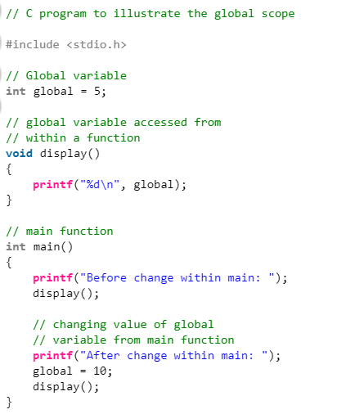
Global Scope

Slide 4
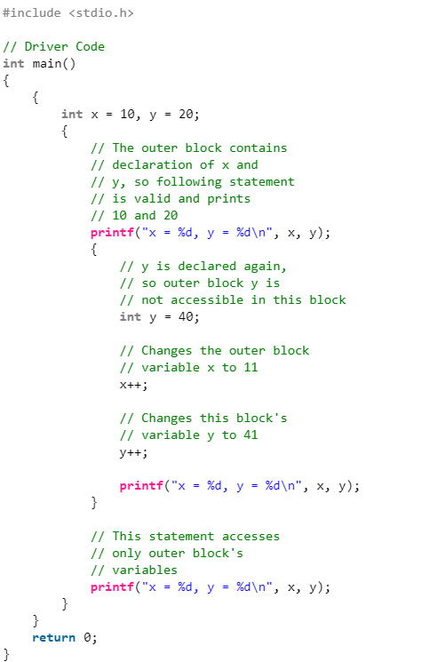
Block Scope

Slide 5
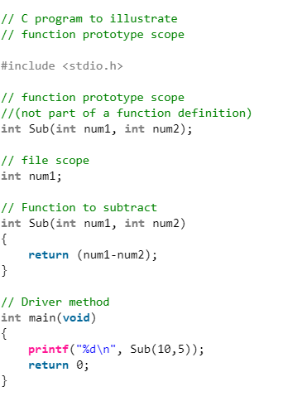
Function prototype Scope

Slide 6
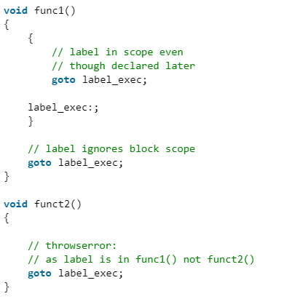
Function scope: Function scope is applicable to labels only

Slide 7
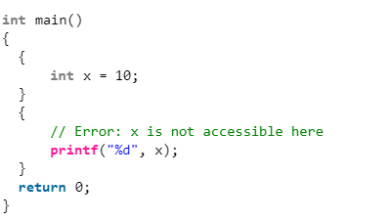

Slide 8
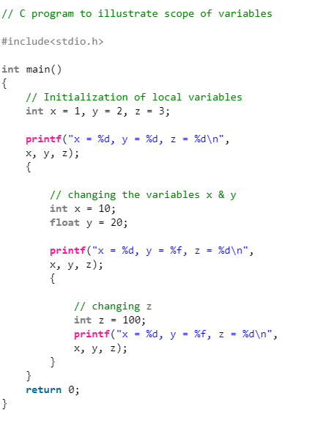

Slide 9
Operators
Unary and Binary operators
Arithmetic Operators (+, -, *, /, %, post-increment, pre-increment, post-decrement, pre-decrement)
Relational Operators (==, !=, >, <, >= & <=) Logical Operators (&&, || and !)
Bitwise Operators (&, |, ^, ~, >> and <<)
Assignment Operators (=, +=, -=, *=, etc)
Other Operators (conditional, comma, sizeof, address, redirection)

Slide 10
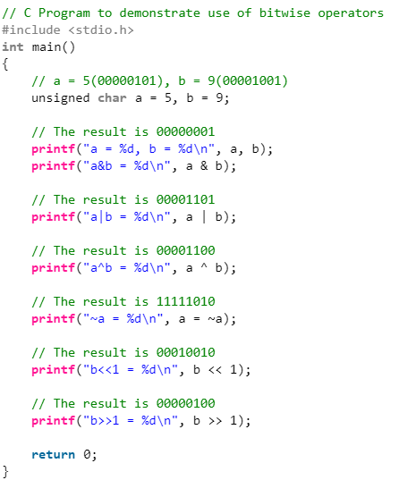
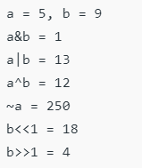

Slide 11
Points to remember
The left shift and right shift operators should not be used for negative numbers.
The bitwise XOR operator is the most useful operator from technical interview perspective.
The following are many other interesting problems using XOR operator.
Find the Missing Number
swap two numbers without using a temporary variable
A Memory Efficient Doubly Linked List
Find the two non-repeating elements.
Find the two numbers with odd occurences in an unsorted-array.
Add two numbers without using arithmetic operators.
Swap bits in a given number/.
Count number of bits to be flipped to convert a to b .
Find the element that appears once.
Detect if two integers have opposite signs.

Slide 12
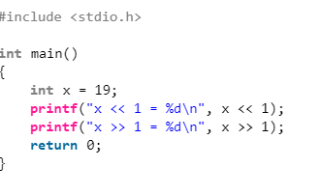
The bitwise operators should not be used in place of logical operators.
The left-shift and right-shift operators are equivalent to multiplication and division by 2 respectively.

Slide 13
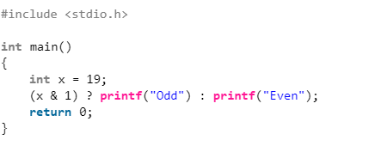
The & operator can be used to quickly check if a number is odd or even.

